Slide 1


Predictive model to classify profitable borrowers
Identify customers who will either fully pay their loans or their loans needs to be charged off
Prepared By: Souvik Ganguly,
Date: 20th May 2024

Slide 2
Index
Index
Executive summary
Project roadmap
Data Quality Analysis and Data Quality report
Exploratory Data Analysis
Part-1 Columns with Missing Values
Part-2: Columns with no missing values
Part-3: New Feature Creation
Segmentation
Part-1 Data Preparation
Part-2 Model Iterations
Part-3 Cluster analysis formed with optimal cluster number=2, 3 and 4
Part-4 Segmentation Conclusion
Next Steps to be continued..
Appendix

Slide 3
Executive Summary
Objective:
The bank is facing significant financial losses due to loan defaults, which directly impacts profitability and risk management. To address this issue, the bank aims to develop a predictive model that can accurately identify borrowers who are likely to fully repay their loans versus those who are at risk of defaulting (Charged Off).
By leveraging comprehensive data on loan applications, borrower demographics, and historical payment behavior, this project seeks to enhance the bank's loan approval process, minimize default rates, and optimize lending decisions. The goal is to improve the bank's overall financial health and customer satisfaction through data-driven insights and predictive analytics.
Build a robust model that will predict whether the borrower will be profitable for the bank. We have a dataset that consists of:
Borrower’s identification data
Borrower’s loan data
Borrower’s demographic data
Borrower’s verification data
Data/ time data
Borrower’s transaction data
Borrower’s hardship data
Borrower’s debt settlement data
Borrower’s application data
Key Steps to achieve the objective:
Data Quality Analysis
Exploratory data analysis: Handling Missing values and Outliers
Feature engineering
Customer Segmentation
Model development for classification
Expected Outcome: Improved accuracy in predicting loan defaults thus enabling better decision making for loan approvals. Click here to visit the github repository of this project

Slide 4
Project Roadmap
Start
No
Management decision
Model Owner
Model Sponsor
Model Developer
Model Tester
Model Governance
Envisions an objective and discusses with major stakeholders
Get Approvals from MO and MS
Get Approvals from MO and MS
Get Approvals from MO and MS
Get Approvals for the best model
Approvals on all the governance documents
No
Yes
Not Approved
Discussion on the budget and feasibility of the project
Not Approved
Re-source the data
Approved
Approved
Not Approved
Yes
Get the source data and Create frozen copy
Generate a report of all the columns. Suggest whether the column needs to dropped if missing values >= 40%, how to handle missing values for rest of the columns, handle outliers, distribution transformation required etc
Develop customer segmentation. Get approved from MO, MS. Develop multiple models, present best 5 models to MO, MS
Data Quality Analysis and Generate Data Quality report
Discussions on the objective of the model and discusses various ways to achieve the objective, timelines and break down the deliverables
Feature Engineering
SIT and UAT of the below files to be done:
.py files of data quality, data preprocessing, feature engineering
Pickle file of clustering model and classification model
Document the end-to-end life cycle of the Model in collaboration with the model developer. Terms of reference, Model approval form, model testing document, model document , approvals of all the stakeholders in each step etc

Slide 5
Data Quality Analysis and Data Quality report
Data sourced from an open-source platform: Hugging Face Datasets
Data Quality script executed on the sourced data.(Click here to find the Data quality scripts. Section: 2.0 Generate an exhaustive Data Quality Report)
The script generates a Data Quality report with below data points:
1. Missing value %
2. Number of Unique values
3. Data Types
4. Descriptive statistical measures
5. Type of distribution
For the complete data quality report, click here
Summary:
Since there’s lack of stakeholder discussion here, assuming the stakeholder agreed on deleting the columns with > 40% missing values due to lack of data and lack of relevance of the columns. 151 columns reduced to 93 columns
Summary of Data Quality Report
No. of numerical variables | 113
No. of categorical variables | 38
No. of variables with null values > 40% | 58
No. of variables with null values > 10% and <=40% | 1
No. of variables with null values > 0% and <=10% | 46
No. of variables with no null values | 46

Slide 6
Exploratory Data Analysis and Feature Engineering

Slide 7
Part-1 Columns with Missing Values
An initial report is extracted using the dataset which has:
Descriptive statistical data for Numerical Variables: count, mean, median, standard deviation, percentiles(0, 25, 50, 75, 100), min, max and missing values %.
Value data for categorical variables: count of each category, % of fully paid and charged off loans for each categories etc.
Click here to find the script generating the above output.
Based on the above report, analysis of each feature with missing values in the dataset is conducted. Click here to find the script of Exploratory data analysis.
A summary report is created to address:
Columns to be dropped
Missing values treatment techniques
Outlier treatment techniques
Distribution transformation techniques
Possible new variables using existing variables
For the complete analysis report on columns with missing values, click here
Summary:
Top-view Summary of Data Quality Report
No. of variables under scope | 47
No. of categorical variables | 12
No. of numerical variables | 35
No. of columns to be dropped. (Variable list to be dropped in appendix) | 34
No. of variables where outlier imputation is required | 0
No. of variables where box_cox transformation is required | 11
No of new variables to be created | 5

Slide 8
Part-2 Columns with no Missing Values
An initial report is extracted using the dataset which has:
Descriptive statistical data for Numerical Variables: count, mean, median, standard deviation, percentiles(0, 25, 50, 75, 100), min, max and missing values %.
Value data for categorical variables: count of each category, % of fully paid and charged off loans for each categories etc.
Click here to find the script generating the above output.
Based on the above report, analysis of each feature with no missing values in the dataset is conducted. Click here to find the script of Exploratory data analysis.
A summary report is created to address:
Columns to be dropped
Missing values treatment techniques
Outlier treatment techniques
Distribution treatment techniques
Possible new variables using existing variables
For the complete analysis report on columns with no missing values, click here
Summary:
Top-view Summary of Data Quality Report
No. of variables under scope | 46
No. of categorical variables | 18
No. of numerical variables | 28
No. of columns to be dropped. (Variable list to be dropped in appendix) | 29
No. of variables where outlier imputation is required | 0
No. of variables where box_cox transformation is required | 8
No of new variables to be created | 9

Slide 9
Part-3 New Feature creation
Summary: 15 new features have been created from existing variables. Click here to find the script of Data Preprocessing and Feature Engineering.
Post EDA and Feature Engineering, remaining 93 columns has reduced to 44 columns.
Sr No | New Feature | Old feature | Feature creation technique | Old feature dropped?
1 | int_rate_category | int_rate | Binning with a gap of 5% | No
2 | installment_category | installment | % based categorization | No
3 | annual_inc_category | annual_inc | % based categorization | No
4 | delinq_2yrs_category | delinq_2yrs | ‘Y’ if value>=1 else ‘N’ | Yes
5 | revol_bal_category | revol_bal | % based categorization | No
6 | perc_loan_paid | total_rec_prncp | 100* (total_rec_prncp/ loan_amount) | Yes
7 | recoveries_category | Recoveries | ‘Y’ if value is not Null else ‘N’ | Yes
8 | last_fico_range_high_category | last_fico_range_high | Industry standard categorization | No
9 | last_fico_range_low_category | last_fico_range_low | Industry standard categorization | No
10 | inq_last_6mths_binary | inq_last_6mths | ‘Y’ if value is not Null else ‘N’ | Yes
11 | tot_cur_bal_category | tot_cur_bal | % based categorization | No
12 | avg_cur_bal_category | avg_cur_bal | % based categorization | No
13 | total_bal_ex_mort_category | total_bal_ex_mort | % based categorization | No
14 | total_bc_limit_category | total_bc_limit | % based categorization | No
15 | total_il_high_credit_limit_category | total_il_high_credit_limit | % based categorization | No

Slide 10
Segmentation

Slide 11
Part-1 Data Preparation
Dataset of 44 features including both numerical and categorical variables
Data Preprocessing applied to these features:
Creating dummy variables for categorical features
Scaling the numerical variables using StandardScalar
Feature elimination using variance threshold method
Feature elimination using correlation matrix
Data Preprocessing increased 44 features to 64
Hopkins Statistical test: It calculates the Hopkins statistic to evaluate the cluster tendency of the dataset. It prints the Hopkins statistic value.
Null Hypothesis: Dataset is uniformly distributed. Hence no meaningful clusters. Average H <=0.85
Alternate Hypotheis: Dataset is not uniformly distributed. Hence It contains meaningful clusters. Average H > 0.85
Summary:
In this case Alternate hypothesis is true meaning data has meaningful clusters. H> 0.85
Click here to find the script of Data Preparation and performing Hopkins Statistical test (Section 2 of the notebook)
Test # | Hopkins statistics
1 | 0.9648238978692573
2 | 0.9667271706377367
3 | 0.9651389560040534
4 | 0.965542978391139
5 | 0.9646249880857238

Slide 12
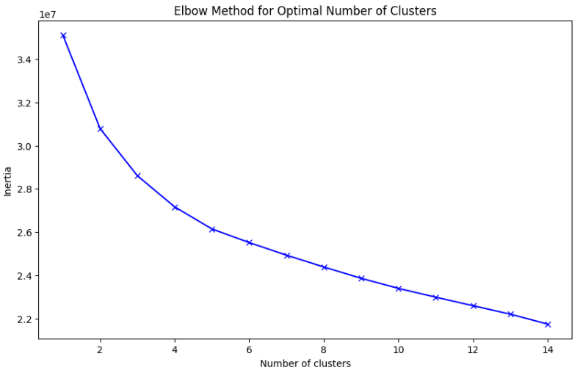
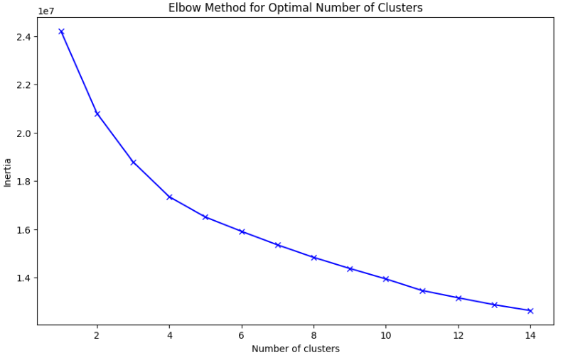
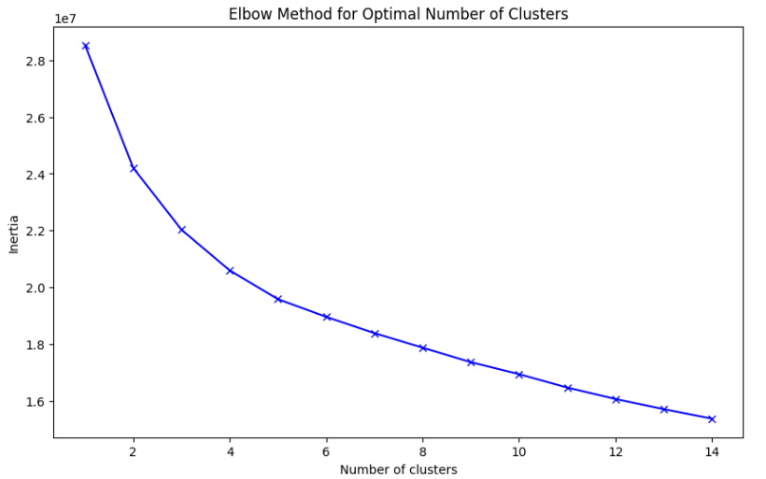
Part-2 Model Iterations
Model is iterated amongst 3 different combinations of data
Preprocessed data in the last step with 64 features
Preprocessed numerical data with 18 variables: All the dummy variables, categorical variables are dropped.
Principal Component Analysis: Reduced features with cumulative_explained_variance >=0.8 which resulted in 16 features
Elbow curve analysis of all 3 iterations resulted in optimal number of clusters=3. Click here to find the script of Elbow curve analysis and Silhouette Analysis for all 3 iterations (Section 3 of the notebook)
Based on the statistical results, clustering with reduced dimensions will give the best result. But assuming that the regulators will resist the PCA transformation since there’s no interpretability of the clusters w.r.t the variables, I’m going ahead with the clustering approach using 2nd iteration(Preprocessed numerical data with 18 variables)
Iteration 1
Iteration 2
Iteration 3
# clusters | Silhouette Score
2 | 0.122
3 | 0.112
4 | 0.081
# clusters | Silhouette Score
2 | 0.140
3 | 0.140
4 | 0.116
# clusters | Silhouette Score
2 | 0.150
3 | 0.141
4 | 0.109

Slide 13
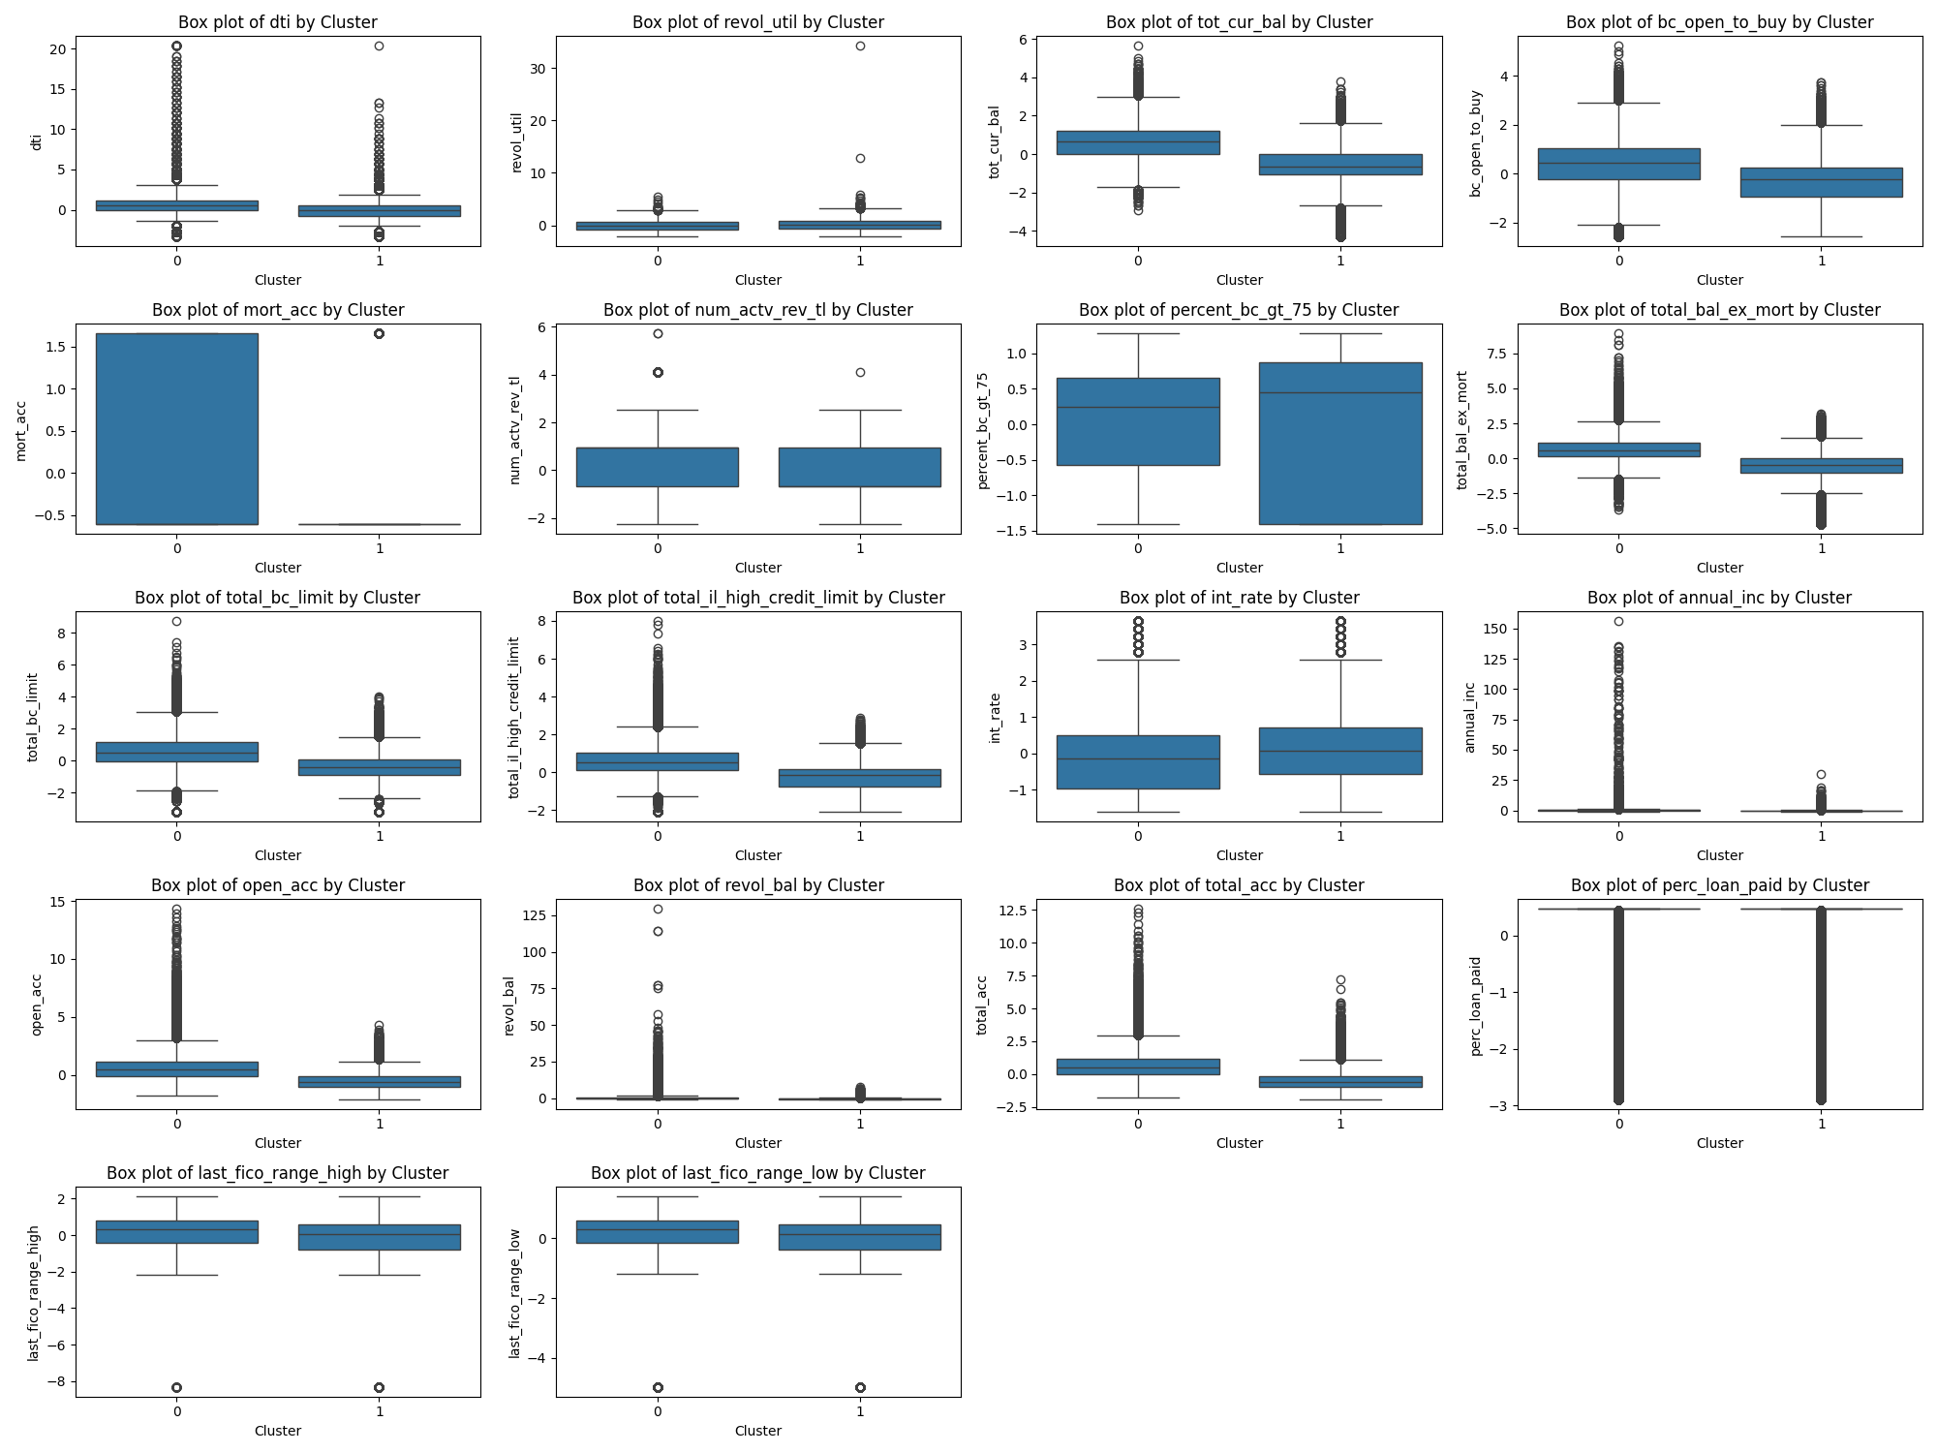
Part-3 Cluster analysis formed with optimal cluster number=2
Click here to find the script of cluster analysis for all k=2, 3 and 4 for the 2nd iteration (Section 3.5 of the notebook)

Slide 14
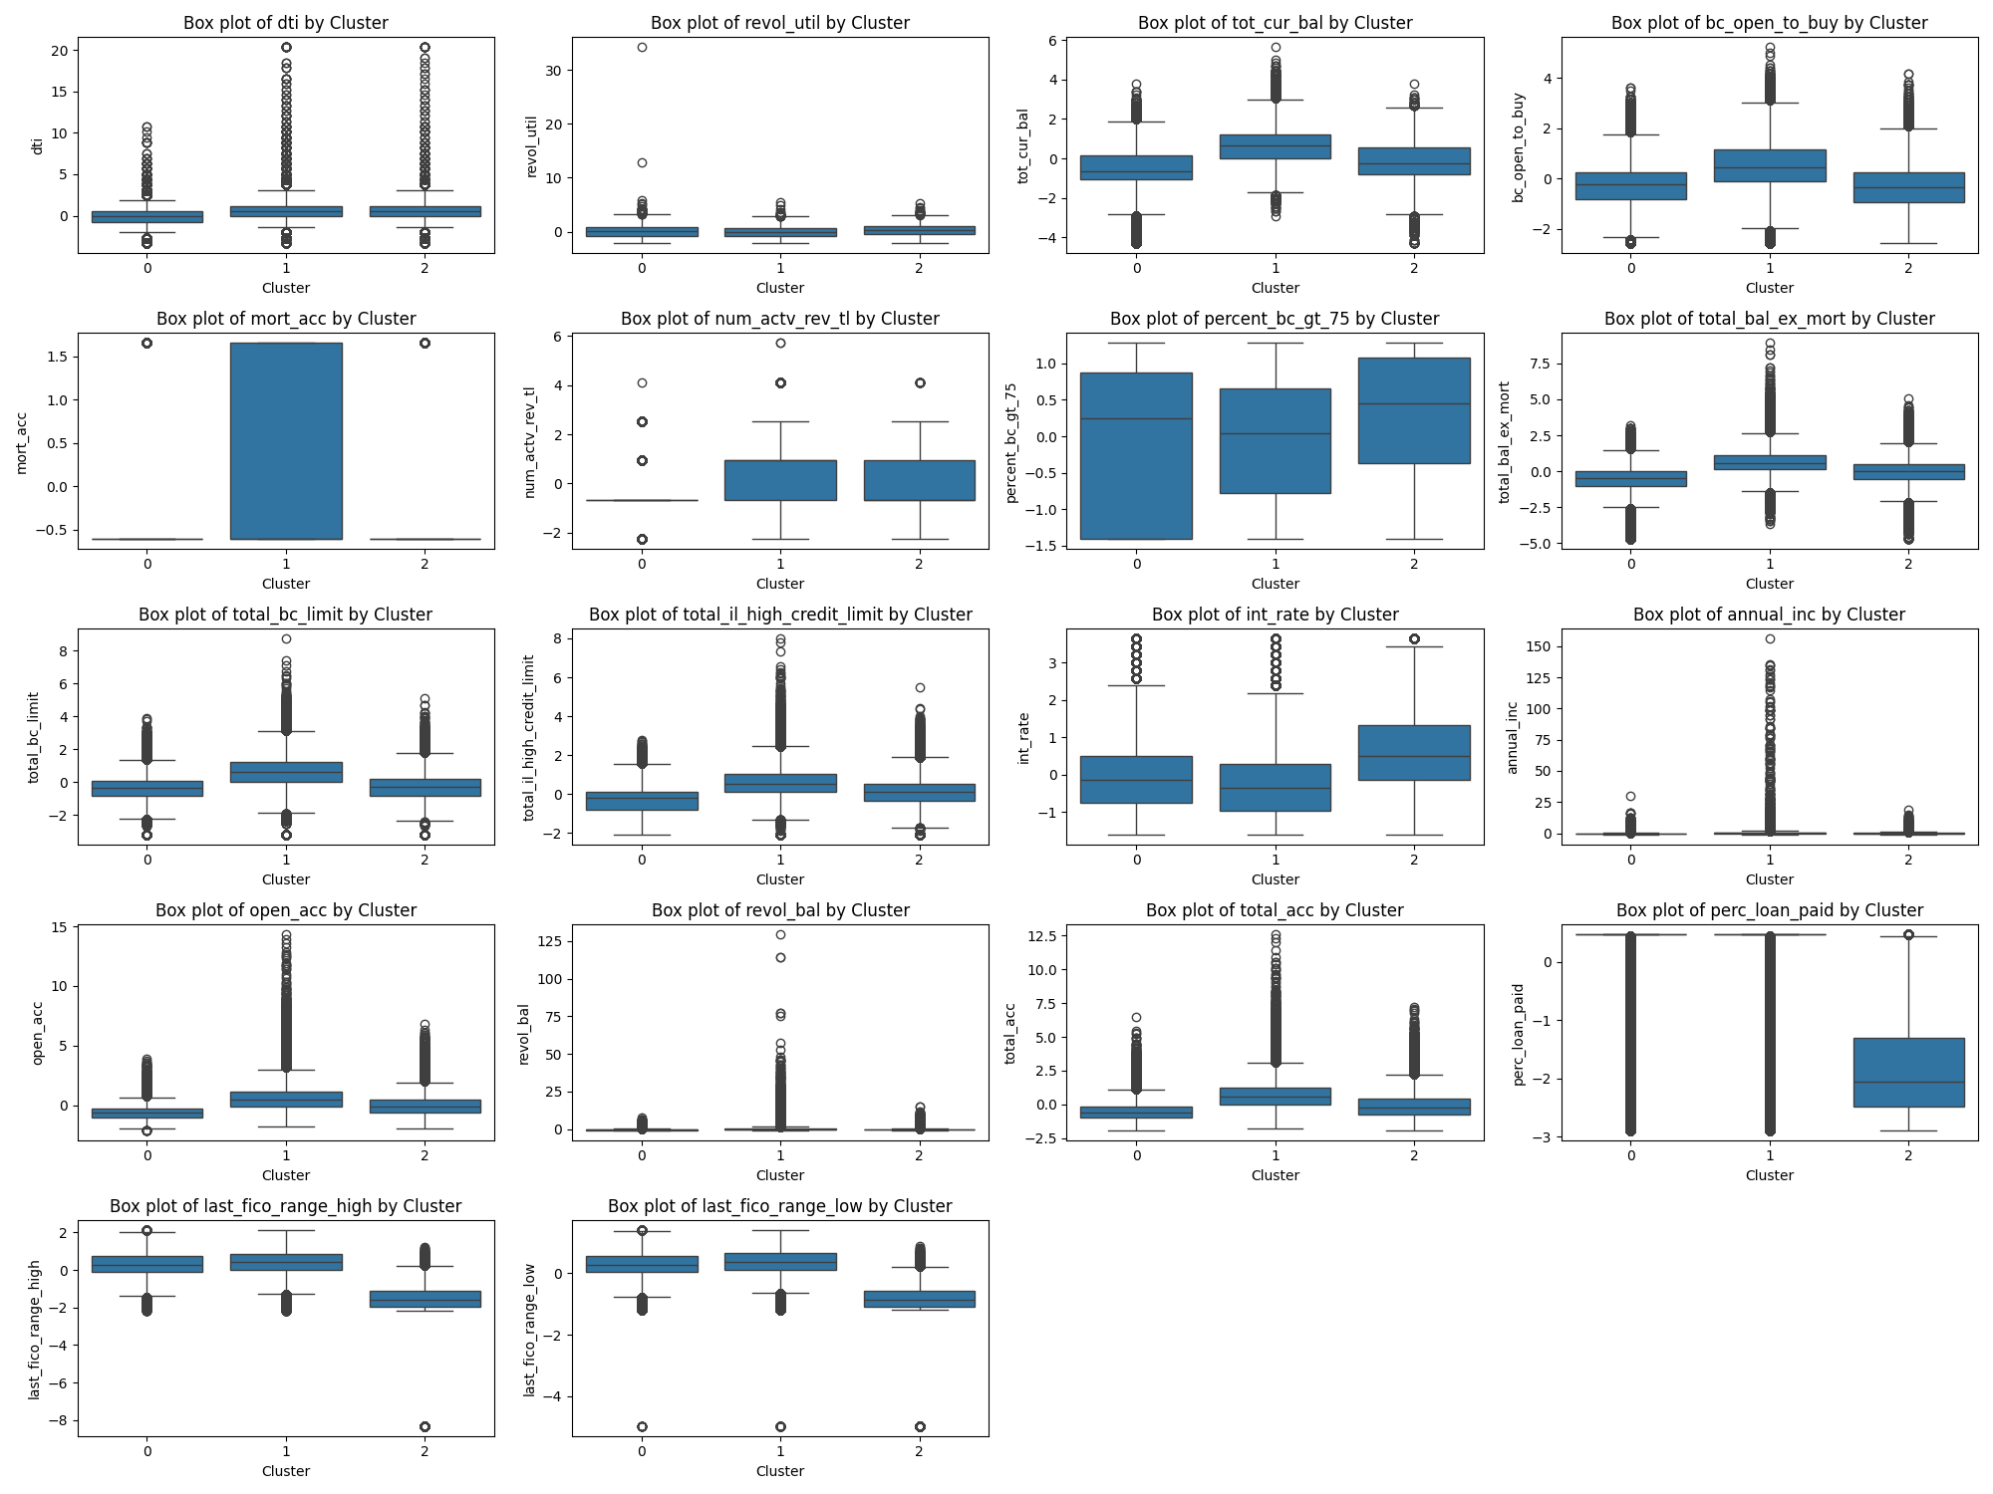
Part-3 Cluster analysis formed with optimal cluster number=3
Click here to find the script of cluster analysis for all k=2, 3 and 4 for the 2nd iteration (Section 3.5 of the notebook)

Slide 15
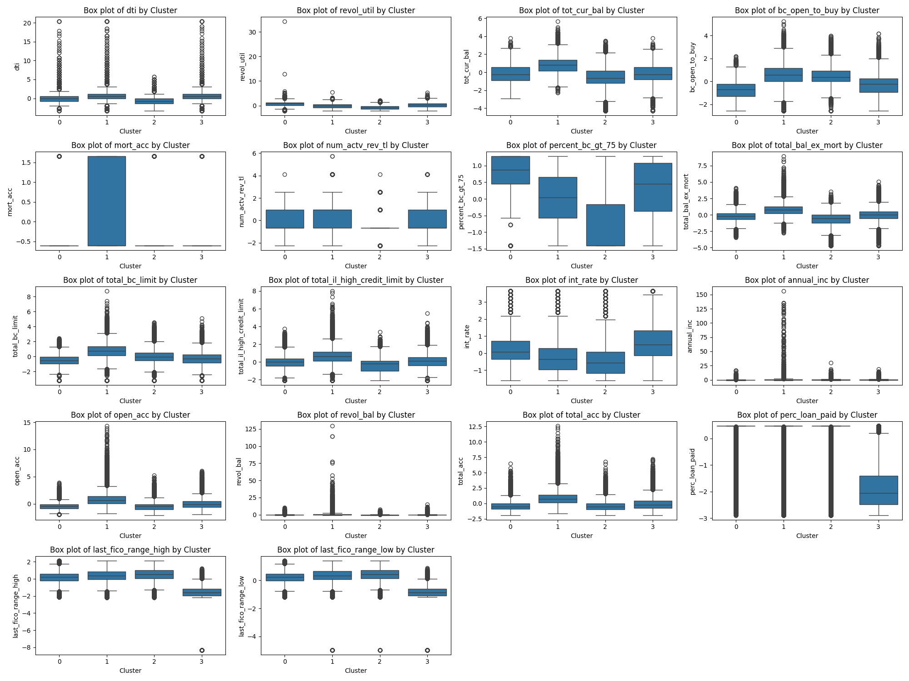
Part-3 Cluster analysis formed with optimal cluster number=4
Click here to find the script of cluster analysis for all k=2, 3 and 4 for the 2nd iteration (Section 3.5 of the notebook)

Slide 16
Part-4 Segmentation Conclusion
The Silhouette score for iteration 2 with optimal number of clusters= 2 and 3 are the best
However, the intra-cluster heterogeneity(based on last 3 slides) between the clusters is missing with optimal number of clusters = 2. The variable distributions for most of the features are similar.
There is required intra-cluster heterogeneity between the clusters with optimal number of clusters = 3 and 4 (More in 4 than 3)
Loan status (target variable) distribution within clusters
Given that, optimal number of clusters=3 has the best Silhouette score and relatively good intra-cluster heterogeneity, our suggestion is to segment the borrowers into 3 clusters.
Review Pending.
Clusters | Fully Paid | Charged Off
0 | 578685 | 17665
1 | 473018 | 28860
2 | 25048 | 222034
Clusters | Fully Paid | Charged Off
0 | 374005 | 6888
1 | 352265 | 27746
2 | 331463 | 13293
3 | 19018 | 220632

Slide 17
Next Steps to be continued..
Classification based on features decided
Model Monitoring framework

Slide 18
THANK YOU
Contact me at
Linkedin
E-mail: Souvik.ganguly.ds@gmail.com
Phone no: (+91) 8141786094

Slide 19
Appendix
Sr No | Description | Attachment
1 | List of columns dropped during feature engineering

